Slide 1
Software Design I
Personal Software ProcessSM for Engineers: Part II

Slide 2
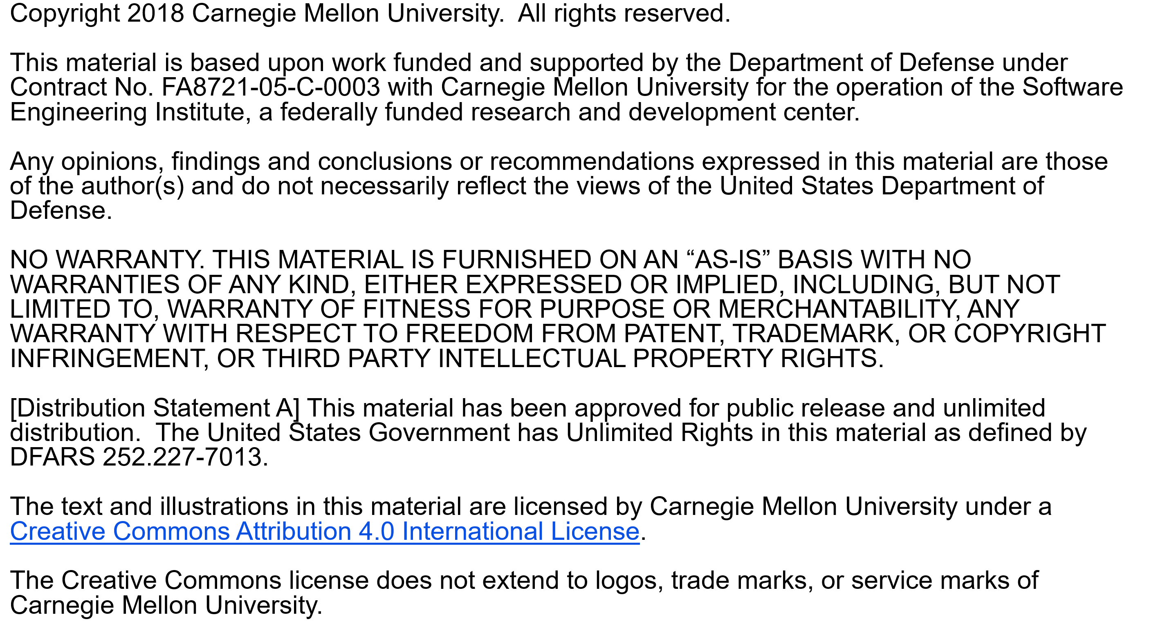

Slide 3
Copyright 2017 Carnegie Mellon University [Distribution Statement A] This material has been approved for public release and unlimited distribution. Please see Copyright notice for non-US Government use and distribution. This material is based upon work funded and supported by the Department of Defense under Contract No. FA8721-05-C-0003 with Carnegie Mellon University for the operation of the Software Engineering Institute, a federally funded research and development center. NO WARRANTY. THIS CARNEGIE MELLON UNIVERSITY AND SOFTWARE ENGINEERING INSTITUTE MATERIAL IS FURNISHED ON AN “AS-IS” BASIS. CARNEGIE MELLON UNIVERSITY MAKES NO WARRANTIES OF ANY KIND, EITHER EXPRESSED OR IMPLIED, AS TO ANY MATTER INCLUDING, BUT NOT LIMITED TO, WARRANTY OF FITNESS FOR PURPOSE OR MERCHANTABILITY, EXCLUSIVITY, OR RESULTS OBTAINED FROM USE OF THE MATERIAL. CARNEGIE MELLON UNIVERSITY DOES NOT MAKE ANY WARRANTY OF ANY KIND WITH RESPECT TO FREEDOM FROM PATENT, TRADEMARK, OR COPYRIGHT INFRINGEMENT. This material is distributed by the Software Engineering Institute (SEI) only to course attendees for their own individual study. Except for the U.S. government purposes described below, this material SHALL NOT be reproduced or used in any other manner without requesting formal permission from the Software Engineering Institute at permission@sei.cmu.edu. The U.S. Government's rights to use, modify, reproduce, release, perform, display, or disclose this material are restricted by the Rights in Technical Data-Noncommercial Items clauses (DFAR 252-227.7013 and DFAR 252-227.7013 Alternate I) contained in the above identified contract. Any reproduction of this material or portions thereof marked with this legend must also reproduce the disclaimers contained on this slide. Although the rights granted by contract do not require course attendance to use this material for U.S. Government purposes, the SEI recommends attendance to ensure proper understanding. PSPSM, Team Software ProcessSM and TSPSM are service marks of Carnegie Mellon University. DM-0004449

Slide 4
Lecture Topics
The design framework
Design completeness
Design representation
The PSP design templates
operational specification
functional specification
state specification
logic specification
The design hierarchy

Slide 5
Design is a Learning Process
Design involves discovery, invention, and intuitive leaps from one abstraction level to another.
While the design must reflect the requirements, requirements usually are not stable until the product has been used, if then.
Design work is iterative, and it must be driven by feedback from all involved parties.
The critical problem is knowing when to freeze the design to produce the next iteration.

Slide 6
The Design Framework

Slide 7
Development Framework

Slide 8
Design Quality
Design is a defect prevention activity.
Poor quality designs are a major source of rework, maintenance, and user dissatisfaction.
A quality design
is complete and precise
meets the user’s needs
precisely guides implementation

Slide 9
Design Levels
Design work is an inverted pyramid in which each level
provides a foundation for the following levels
debugs the preceding levels
To save time and prevent defects, document all design decisions at all levels when they are made.

Slide 10
Structuring the Design Process
Good software designers follow a dynamic process. They
jump from concept to detail
simultaneously consider issues at several design levels
explore multiple alternatives
A structured design process can help you to manage the dynamics of design.
capture what has been learned
record and manage issues
track design status
A properly-implemented design process will reduce rework, manage routine tasks, and give the designer the freedom to be creative.

Slide 11
The Design Hierarchy

Slide 12
The PSP Design Process
Since there is no single best design method, the PSP supports multiple methods.
The PSP focuses on what a complete design should contain.
The goal is to eliminate requirements and design defects.
The PSP uses design templates to provide
criteria for design completeness
reviewable designs

Slide 13
Design Completeness
Under-specified and incomplete designs are expensive and error-prone.
Designs can be over-specified, especially when they are produced without completeness criteria.
In the PSP course, most students find that their designs are incomplete and do not adequately guide implementation.
To avoid over- or under-specification
examine your defect data
establish design completeness criteria
focus on design quality

Slide 14
Design Representation
It is important to separate two issues.
how to do the design
how to represent the design when it is completed
Since the PSP can be used with any design method, it does not specify a specific design approach.
However, the PSP does address design representation.

Slide 15
Design Methods and Notations
There are many design methods.
None have been proven best for every domain.
The best method often depends on individual skills and preferences.
A widely-usable process must work with many different design methods.
There are also many types of design notations.
Graphics assist in visualizing structure.
Formality provides precision.
Text provides intuitive understanding.
Often all three types of design notations are needed.

Slide 16
Poor Design Notations Cause Defects
Design visibility
Complex designs are difficult to visualize.
A poor representation compounds visualization problems.
A well-represented design captures all design decisions unambiguously.
Design redundancy
A redundant design is often inconsistent.
Inconsistency breeds errors and causes defects.
A quality design has minimum duplication.
Where possible, use design tools that ensure consistency.

Slide 17
Design Notation Requirements
The design notation must
precisely define all significant design aspects
be commonly understood
communicate the designers’ intent
help to identify design problems and omissions
be suitable for representing a broad range of designs
The design should also
be concise and easy to use
provide a complete and accessible reference
have minimum redundancy
Formal notations meet these criteria.

Slide 18
Using Formal Notation
Advantages: using a formal notation
produces precise and compact designs
builds familiarity with an important notation
is consistent with the notation used in formal methods for proving program correctness
distinguishes logic from other expressions
Disadvantages: formal designs
generally take more time to create
take practice to build familiarity
may not be understood by users and co-workers

Slide 19
Mathematical Notation

Slide 20
Program Functional Statements
When describing program functions, actions and conditions are separated.
Condition → Action
Read, “When Condition is true, do Action.”
Several condition/action pairs are written as
Condition A → Action A | when Condition A, do Action A
∨ | or
Condition B → Action B | when Condition B, do Action B
∨ | or
Condition C → Action C | when Condition C, do Action C

Slide 21
Notation Examples -1
If x is positive, set y to zero.
x > 0 → y := 0
If x is even, return the sum of x and y, otherwise return the difference between x and y.
even(x) → return( x + y ) Ú odd(x) → return( x – y )

Slide 22
Notation Examples -2
State that an array a[0..N-1] has no duplicate elements.
This expression reads as follows.
For all indexes i and j with values in the range 0 to N-1, where i and j are not equal, the corresponding elements of the array a are not equal.

Slide 23
Users of Design Information
The principal users of the design are
implementers
design reviewers and verifiers
testers and test developers
documenters, maintainers, and enhancers
These users potentially need a large amount of material.
Not all information is needed immediately.
Some information can be obtained from other sources.
It is wise to limit the design workload as much as possible.

Slide 24
Essential Design Information
The information that designers should provide includes
a picture of where the program fits into the system
a description of how the program will be used
a specification for all related classes and parts
a structural view of the product
a specification of all external calls and references
a list of all external variables, parameters, and constants
a clear statement of the program’s logic
The essential design information can be categorized into static or dynamic views, and internal or external views.

Slide 25
Design Views

Slide 26
Design Templates
Four design templates are used in the PSP to cover the four design views.
operational specification template
functional specification template
state specification template
logic specification template
These four templates provide the framework for completely and precisely recording a software design.

Slide 27
Mapping Templates to Views

Slide 28
Operational Template
The operational specification template describes the users’ normal and abnormal interactions with the system.
It contains the
principal user actions and system responses
anticipated error and recovery conditions
The operational specification template can be used to
define test scenarios and test cases
resolve development questions about operational issues
resolve requirements discussions with users

Slide 29
Example Operational Template

Slide 30
Operational Template Class Exercise -1
For this exercise, as a class, we will produce an operational scenario template for program 5.

Slide 31
Functional Template
The functional specification template allows you to unambiguously define the external functions provided by the product.
classes and inheritance
externally visible attributes
external functions provided
relationships with other classes or parts
Where possible, specify the behavior of each function or method with a formal notation.

Slide 32
Example Functional Template

Slide 33
Producing the Functional Template
To produce a functional template, you must
decide how to build the product
define the product’s functions
define the key product attributes
The functional specification is usually developed in steps.
Produce an initial design.
Refine the elements of that design.
Revise the functional specification template as you better understand how to build the product.

Slide 34
Functional Template Class Exercise -1
For this exercise, as a class, we will produce a functional specification template for program 5.
We’ll start by quickly sketching out a design of program 5.

Slide 35
Functional Template Class Exercise -2
Next, we will produce a functional specification template for program 5.

Slide 36
State Specification Template -1
The state specification template (SST) precisely defines
the program states required
transitions among the states
actions taken with each transition
With the SST, you can
define state machine structure
analyze the state machine design
recognize mistakes and omissions

Slide 37
State Specification Template -2
The SST specifies
the name of every state
a brief description of each state
the name and description of any functions or parameters used in the SST
the conditions that cause transitions from the state to itself or to any other state
the conditions that cause transitions from any other state to this state
the actions taken during each transition

Slide 38
Example State Template

Slide 39
Logic Specification Template -1
The logic specification template precisely defines the program’s internal logic.
Its objective is to describe the logic in a concise and convenient notation.
A pseudocode compatible with the implementation language is often appropriate.
Formal notation is also appropriate.
Both the designers and the implementers must be familiar with the notation used.

Slide 40
Logic Specification Template -2
The logic specification template should specify
the logic for each item or method, each part and class, and the overall program
the precise call to each program, part, or method
any external references
special data types and data definitions

Slide 41
Example Logic Template

Slide 42
Using Pseudocode
In producing pseudocode designs
use spoken language
where possible, avoid programming constructs
where unavoidable, use constructs from the implementation language
where the program’s action is clear, make a brief note
be more specific about complex constructs, loops, and state-machine structures
Consider writing the pseudocode in your development environment.
Later, when implementing the program, include the pseudocode in the comments.

Slide 43
Logic Template Class Exercise -1
For this exercise, as a class, we will produce a logic specification template for a function in program 5.

Slide 44
Using Design Templates
The PSP design templates provide one way to represent a design.
They are precise, unambiguous, non-redundant, and complete.
Use the PSP design templates in conjunction with your other design methods.
Other representations may be substituted if they are equally precise, unambiguous, non-redundant, and complete.

Slide 45
Design Guidelines
When designing large programs, use a dynamic design strategy that allows for uncertainty.
Some design problems cannot be resolved without first building and testing a potential solution. For these cases, use prototyping.
When modifying or enhancing an existing system without a documented design, use the design templates to record the design as you decipher it.

Slide 46
The Design Hierarchy
You can use the design templates to refine the specification and design of large or small software products.
system
program
component
module
Starting with requirements, produce a set of design templates to describe the highest-level product.
Use these design templates as the requirements for producing the design templates for the next product level.

Slide 47
Program Design

Slide 48
Module Design

Slide 49
Messages to Remember
While design is a creative process, its routine aspects can be defined.
A good design notation will reduce design defects.
Using precise design specifications and formats will improve design quality.
Use the PSP design templates in the course exercises, and whenever you can do so in your work.

